Slide 1

Malla Reddy Engineering College for Women
UGC Autonomous Institution
Accredited by NBA & NAAC with A+ Grade
Approved by AICTE , Affiliated to JNTUH , ISO 9001:2015 Certified Institution
Maisammaguda , Dhulapally , Secunderabad-500100
Title of the Idea : CalmConnect: Empowering Your Mental Wellness Journey using web technologies and open AI
Name of the Student : B. Jyothika, A. Neha, E. Vaishnavi
Guide Name : Dr. Kalpana
Branch & Year : IIIrd Year & AIML(A)
Roll Number : 22RH1A6625 22RH1A6606 22RH1A6650

Slide 2
CLAM CONNECT
INTRODUCTION
Mental well-being is a crucial aspect of overall health, yet many individuals struggle to assess and understand their mental state. CALM CONNECT is an open-source project designed to empower individuals by providing a self-assessment tool to evaluate conditions such as depression, anxiety, and OCD.
This platform offers a structured questionnaire that analyzes user responses and provides personalized insights, helping users gain a better understanding of their mental health. Along with self-assessment, the platform also offers educational resources to promote mental health awareness and guide users toward appropriate self-care practices or professional support if needed.

Slide 3
CLAM CONNECT
PROBLEM STATEMENT
Mental health issues like depression, anxiety, and OCD affect millions worldwide, yet many individuals struggle to access timely support due to stigma, lack of awareness, or limited resources. Traditional mental health assessments and treatments can be costly, time-consuming, and inaccessible, leaving many without the help they need.
Challenges:
Lack of awareness and early detection of mental health conditions.
Social stigma preventing individuals from seeking professional help.
Limited access to affordable and reliable mental health resources.
Difficulty in tracking emotional well-being and progress over time.

Slide 4
CLAM CONNECT
Allow users to assess their mental health through personalized questionnaires related to common conditions like depression, anxiety, and OCD.
Provide tailored suggestions for self-care strategies, coping mechanisms, and professional resources based on assessment responses.
Enable users to identify mental health issues early and encourage timely action for seeking help.
Ensure secure, private assessments to protect user data and reduce stigma around mental health.
Offer a platform that is easily accessible, providing essential mental health information and support regardless of location.
Support users in enhancing emotional resilience and overall mental health through tools and resources.
OBJECTIVES

Slide 5
CLAM CONNECT
EXISTING SYSTEM
A questionnaire that helps detect possible mental health conditions.
Resources and support materials related to mental well-being.
Disadvantages:
The application lacks responsiveness.
It relies on human work.
The user undergoes into a long procedure.

Slide 6
CLAM CONNECT
PROPOSED SYSTEMS
The CALM CONNECT is a web-based platform designed to help users assess their mental well-being through a structured survey. Based on responses, it analyzes conditions such as depression, anxiety, and OCD, providing personalized insights and self-care recommendations. The system ensures user privacy and confidentiality while offering accessible mental health support.
Advantages
Easy & Accessible – Simple, user-friendly interface.
Personalized Insights – Provides tailored mental health assessments.
Self-Care Support – Offers coping strategies and wellness tips.
Early Detection – Helps users identify potential issues early.
Secure & Confidential – Ensures data privacy and anonymity.
Cost-Effective – Free or low-cost alternative to professional consultations.

Slide 7
CLAM CONNECT
METHODOLOGY
User takes survey
Data processing
Result generation
Recommendations
Data storage & security
Deployment & update

Slide 8
CLAM CONNECT
RESULTS
The CALM CONNECT is a project aiming to assist individuals in managing their mental health. The application offers several key features:
Chatbot Interaction: Users can engage with a chatbot designed to provide conversational support.
Diagnostic Questionnaire: The app includes a questionnaire intended to identify potential mental health issues the user may be experiencing.
Resource Compilation: A curated collection of resources is available to support the user's mental well-being.
Technical Specifications:
API: Utilizes the OpenAI API for chatbot functionalities.

Slide 9
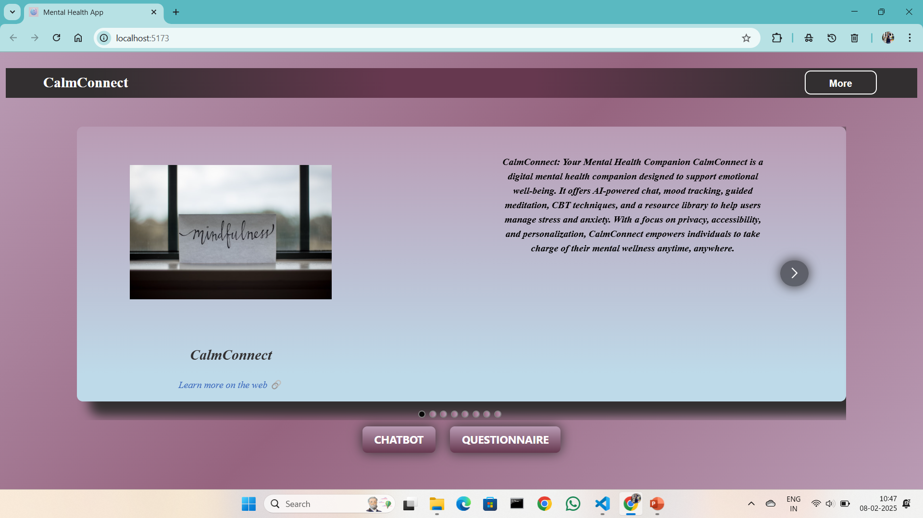
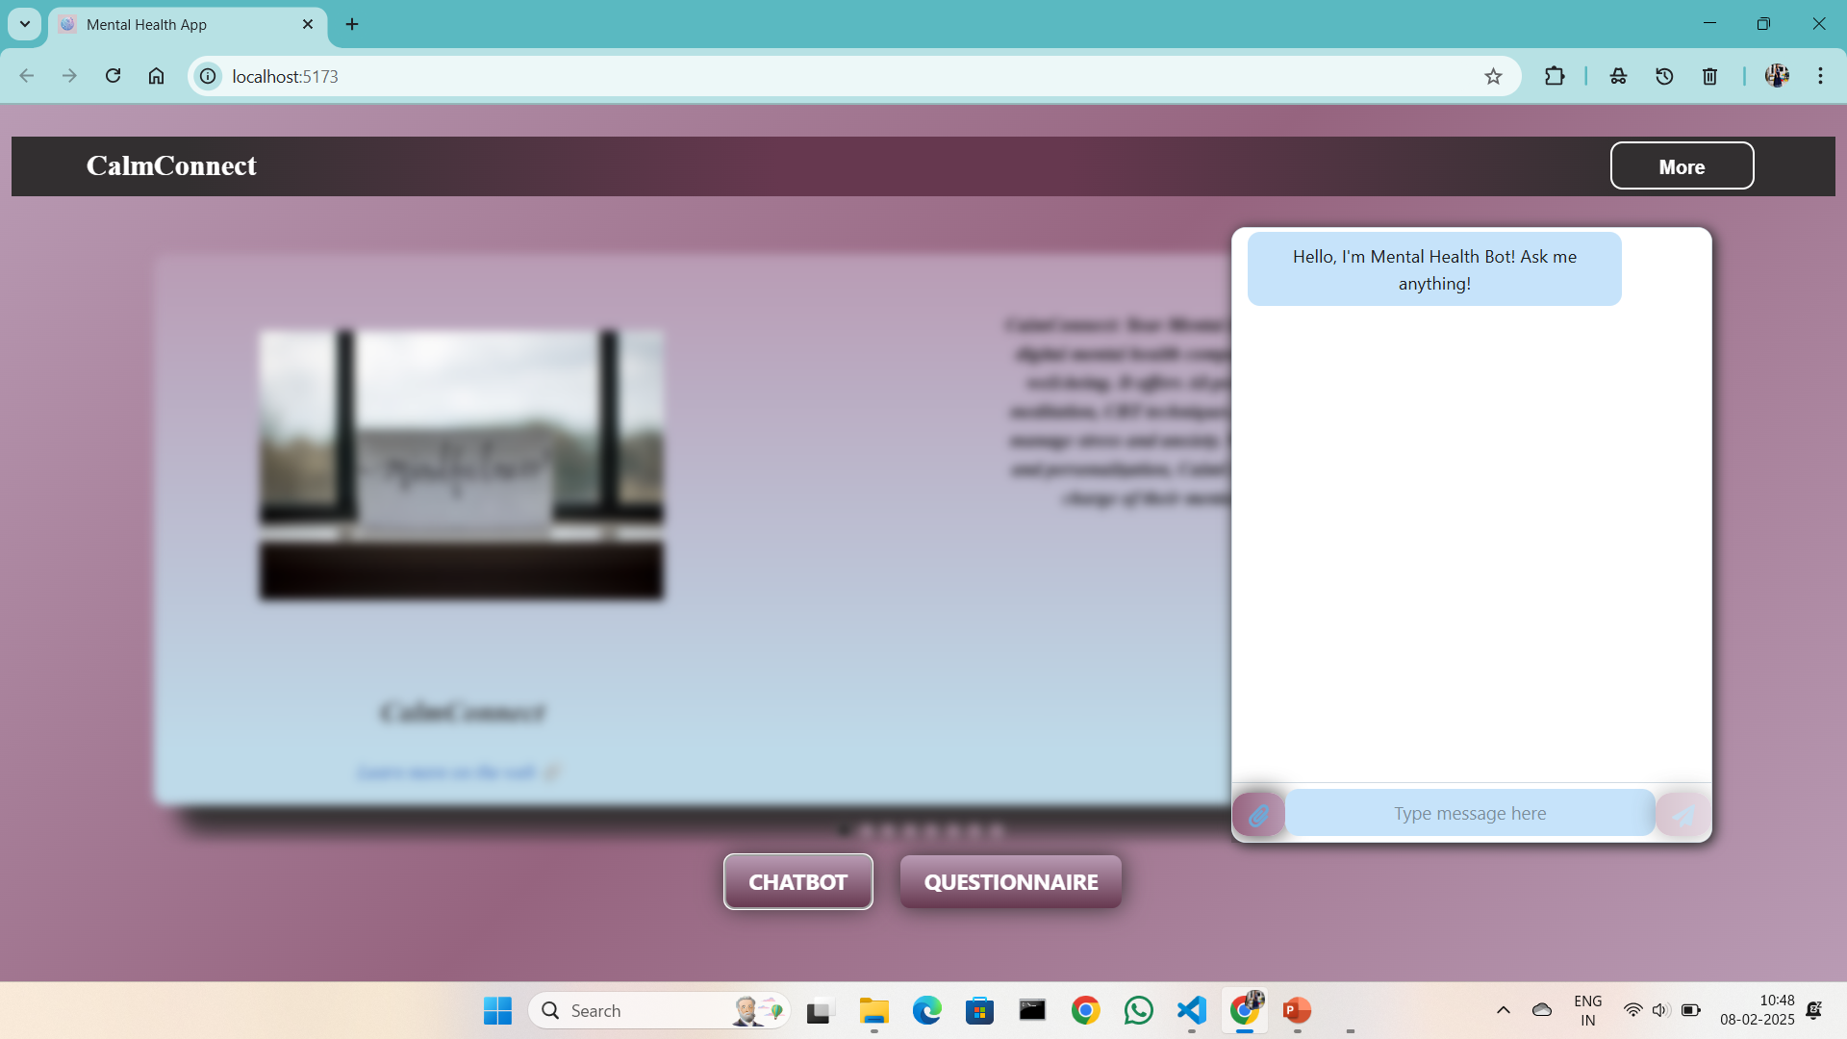
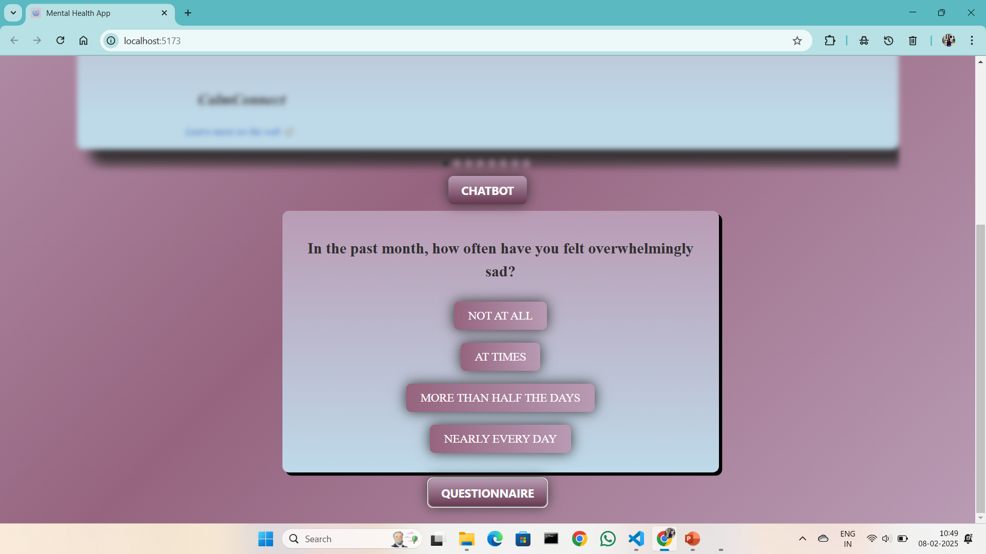
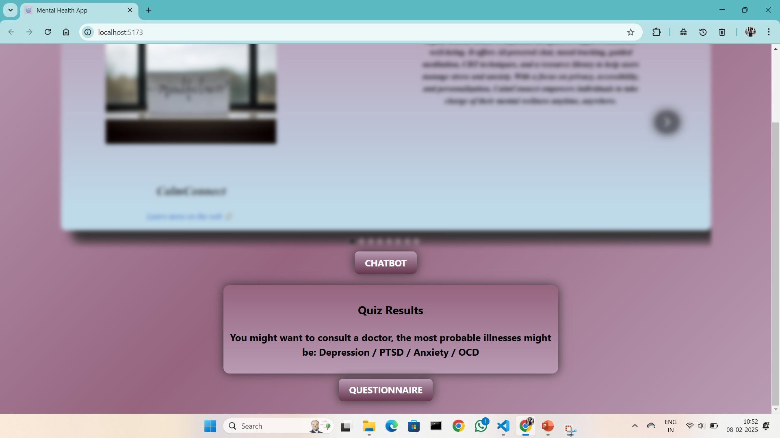

Slide 10
CLAM CONNECT
CONCLUSION AND FUTURE SCOPE
Conclusion
The CALM CONNECT serves as a valuable tool in promoting mental well-being by offering self-assessments, insights, and resources for managing mental health conditions such as depression, anxiety, and OCD. By integrating technology with psychology, the platform empowers users to understand their emotions better, recognize early warning signs, and seek appropriate support.
Future Scope
AI-Powered Insights – Implementing AI-driven analysis to provide more accurate and personalized mental health assessments.
Integration with Wearable Devices – Syncing with smartwatches and fitness trackers to monitor stress, heart rate, and sleep patterns.
Chatbot Support – Introducing an AI-based chatbot for real-time emotional support and guidance.

Slide 11
CLAM CONNECT
REFERENCED
World Health Organization (WHO) – Mental health resources and global statistic. https://www.who.int/health-topics/mental-health
American Psychological Association (APA) – Guidelines on mental health assessments and therapy. https://www.apa.org/
National Institute of Mental Health (NIMH) – Research and insights on depression, anxiety, and OCD. https://www.nimh.nih.gov/
Mayo Clinic – Expert articles on symptoms, diagnosis, and treatment of mental health conditions. https://www.mayoclinic.org/diseases-conditions
Harvard Medical School – Health Blog – Latest research and studies on mental well-being. https://www.health.harvard.edu/blog

Slide 12
CLAM CONNECT
THANK YOU

